Slide 1
Chloride & Sodium Concentrations

Slide 2
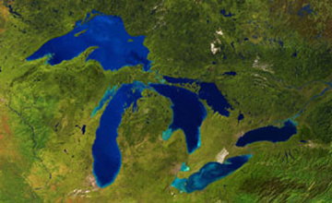
A Bit Smaller…
Conesus | 14 km²
Hemlock | 7 km²
Canadice | 3 km²
Honeoye | 7 km²
Canandaigua | 42 km²
Keuka | 47 km²
Seneca | 175 km²
Cayuga | 172 km²
Owasco | 27 km²
Skaneateles | 36 km²
Otisco | 8 km²
Superior | 82,414 km²
Michigan | 22,400 km²
Huron | 23,010 km²
Erie | 9,930 km²
Ontario | 7,520 km²

Slide 3
Seneca Lake Watershed: Land Use, Subwatersheds & Bedrock Geology

Slide 4
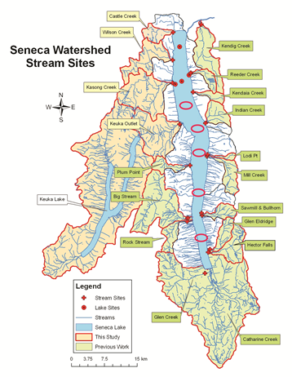
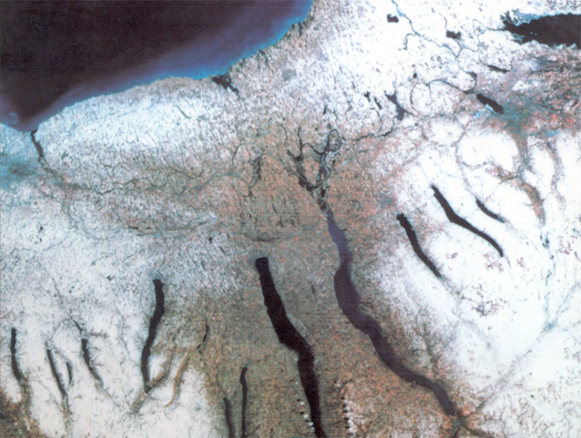
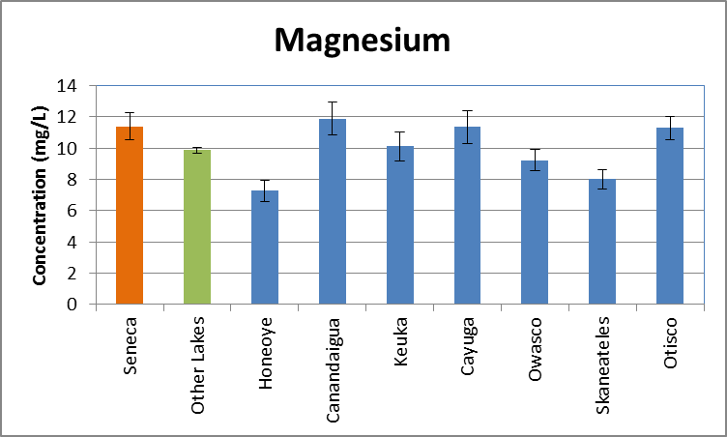
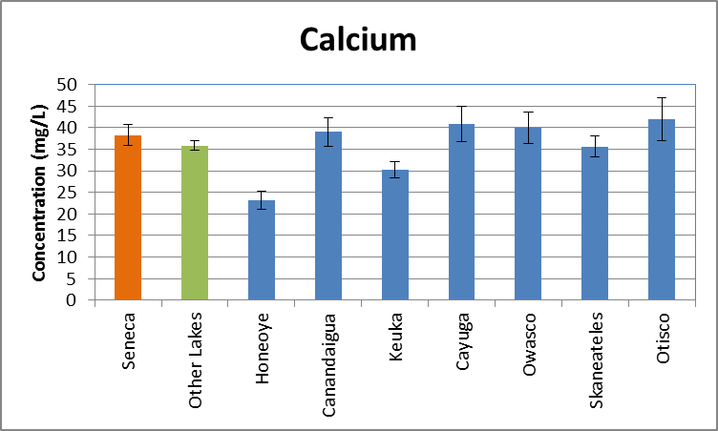
Seneca Lake Salinity Saltiest Finger Lakes
EPA Advisory
Average data from past 20+ years
Halfman, 2014

Slide 5
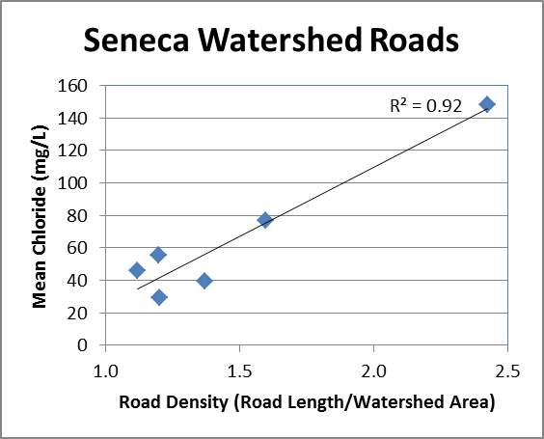
Source? : Chloride & Sodium (1:1 M) Streams? Not Enough to Lake
Streams Reflect:
Road De-Icing Salts
Halfman, 2014

Slide 6
Sources & Sinks: Chloride Ions: Mass Balance Argument
Rain ~0 mg/L Dilutes Ions in Lake
Evaporation ~0 mg/L Concentrates Ions in Lake
Streams 55 mg/L 34,000 mt/yr Road Salt
Seneca Lake
130 mg/L
(~2.2 million mtons)
Outlet 130 mg/L 97,000 mt/yr
Wing et al., 1995
Halfman et al., 2006
Mine Waste 9,000 mt/yr
Sediment Diffusion ~5,000 mt/yr
Inputs << Outputs Not Balanced, Still Need an additional ~50,000 mt/yr (11,000 Railroad cars) to attain lake’s concentration

Slide 7
Finger Lake Bedrock

Slide 8
Basin Depths

Slide 9
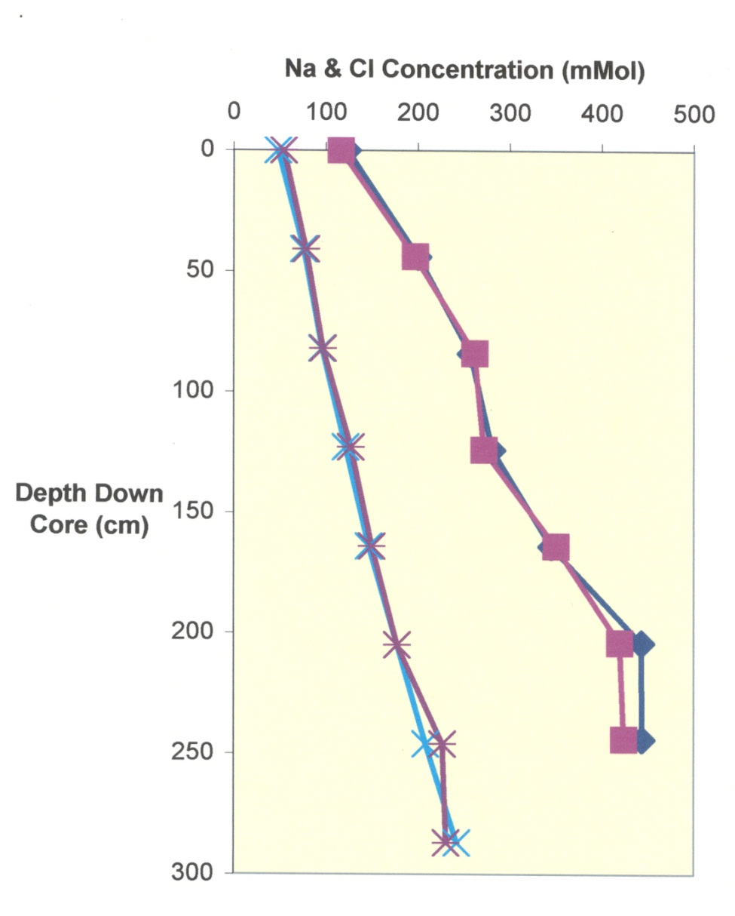
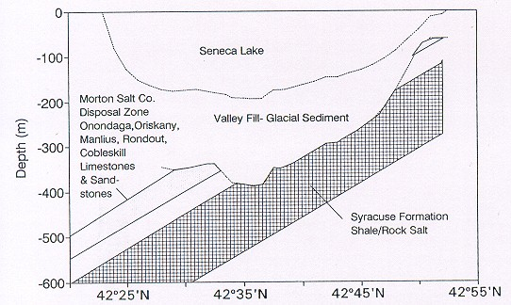
Source Chloride & Sodium Ions
Bedrock X-Section
Lake ~5 mMol
Rock Salt
South
North
Sediment Pore Waters
Rob Stewart, (H’03) Environmental Consulting

Slide 10
Is Seneca Lake too Salty to Drink?

Slide 11
Historical Chloride Concentrations Source Not Constant Over Time
Other Finger Lakes: Road
De-Icing Salts
Seneca & Cayuga
Different
Jolly, 2005 & 2006
HWS Students
Halfman, 2014

Slide 12
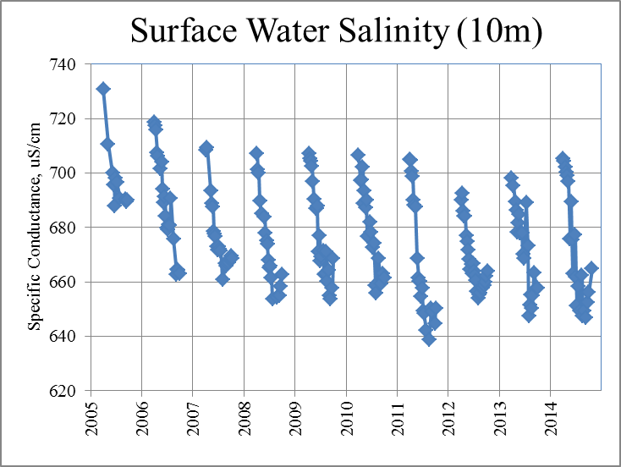
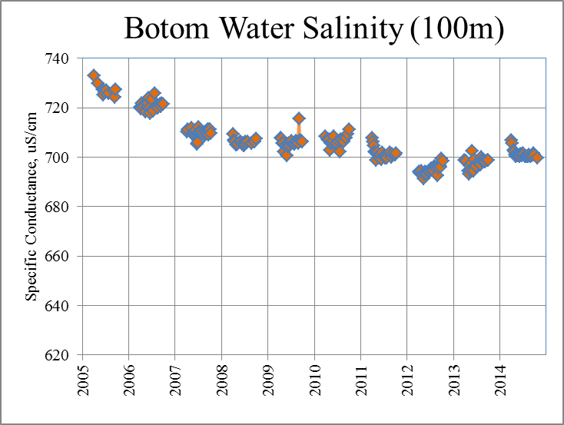
Past Decade Early Spring Water Column Profiles
Declining Salinity

Slide 13
Historical Chloride Concentrations Source Not Constant Over Time
Other Finger Lakes: Road
De-Icing Salts
Seneca & Cayuga
Different
Jolly, 2005 & 2006
HWS Students
Halfman, 2014

Slide 14
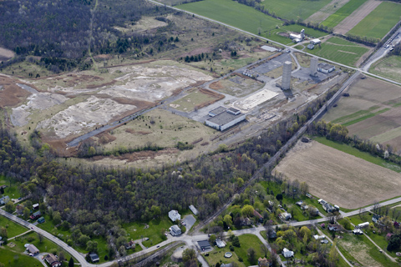
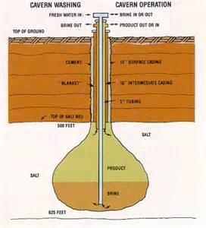
Modeling Seneca Lake Chloride
Potential Sources
Increase in early 1900s
Salt Mining Starts 1880s
Increased Mining to 1960s
Huge Increase 1965
Himrod Mine “Issues”?
Gas Storage by TEMPCO?
Short Lived
Decline/Natural Flushing Since 1970
ANY Groundwater Inputs? Gas was stored!
Halfman, 2014

Slide 15
Modeling Seneca Lake Chloride
Potential Sources
Increase in early 1900s
Salt Mining Starts 1880s
Increased Mining to 1960s
Huge Increase 1965
Himrod Mine “Issues”?
Gas Storage by TEMPCO?
Short Lived
Decline/Natural Flushing Since 1970
ANY Groundwater Inputs? Gas was stored!
Halfman, 2014

